Slide 1
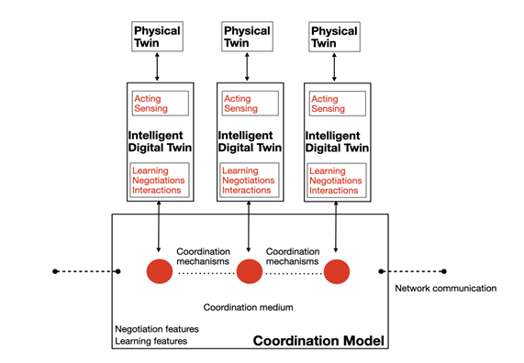
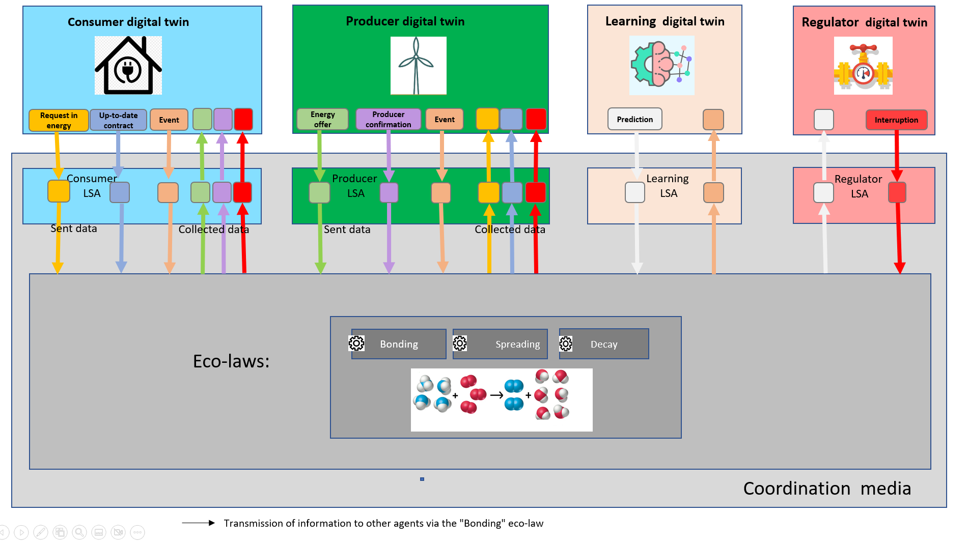
Implementation of a platform of coordination
Implementation of a coordination model using digital twins, a shared virtual environment (tuple space) and coordination laws.
Implementation of digital twins : define agents' behaviors as consumer, producer, learning agent and node regulator. Agents act autonomously, adapt, organize and make decisions according to the situation.
Generation of supply contracts between producers and consumers by using self-adaptation.

Slide 2
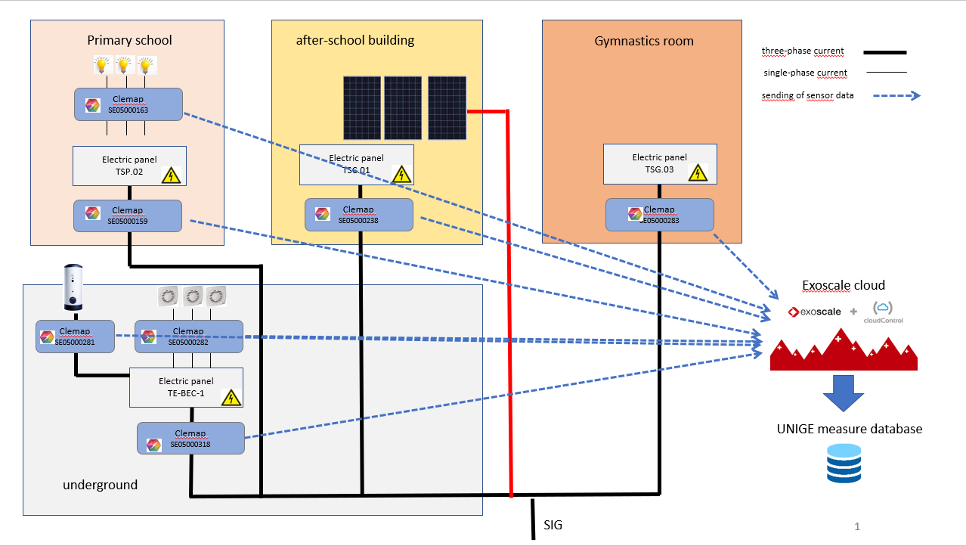
Collect of measures data from Meyrin - Les Vergers
Importation of measures data stored in Exoscale cloud environment:
consumers wattages sent by smart-meters every minute: buildings, floors, appliances
solar panels wattages collected every hour by SIG
Storage of measurement data in a database easily accessible from the coordination platform.

Slide 3
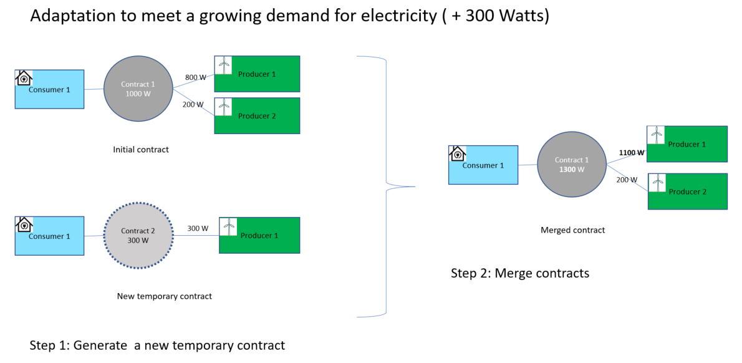
Adaptation of the digital twins
Testing of the consumer/producer digital twins by using the data collected from Les Vergers.
Customization of the digital twins to fit better with real-world situations:
Adaptation of the Markov prediction states to fit with the used powers
Consideration of fluctuation in demand so as not to break a contract after each power change:
Use of a margin in a contract to absorb the power variation
Use of a second « transition contract » when the variation is more important.

Slide 4
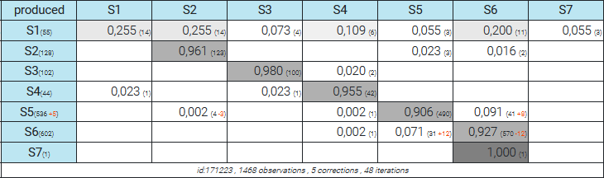
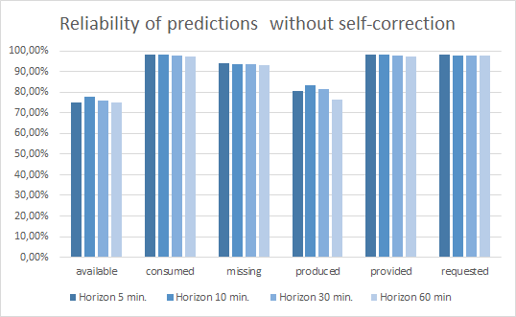
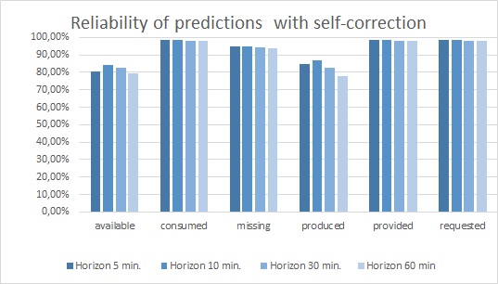
Adaptation of the prediction model
Running of prediction model based on Markov chains by the learning agent
Training of the model by using the data from Les Vergers
Evaluation of the model by comparing the predicted states and the actual state distribution at the time of the horizon.
Generation of prediction statistics to better understand the difficulties faced by the model.
Addition of a self-correction mechanism executed by the learning agent to improve the reliability of predictions.

Slide 5
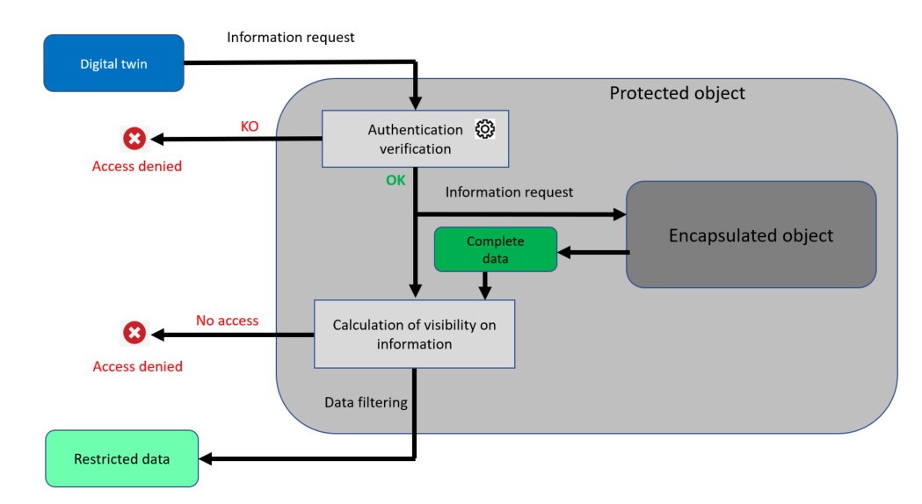
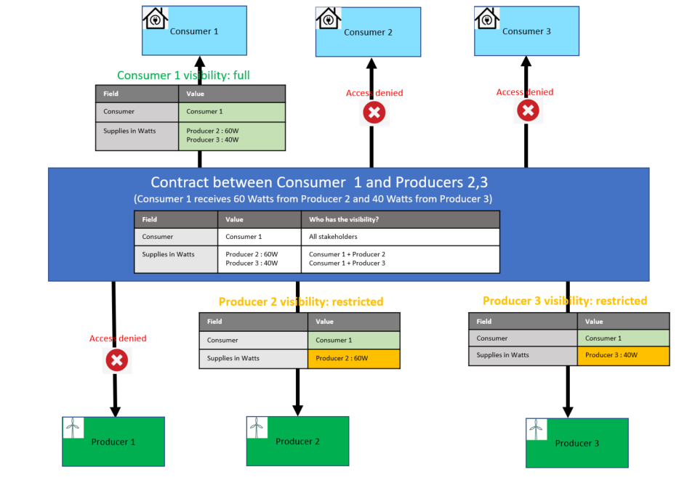
Data protection with access restriction
General mechanism:
use of encapsulation
Example of access restriction:
supply contract between a consumer and 2 producers

